Slide 1
Design Recommendations for PA monitor controls
Source:
1. “Human Factors Design Guidelines for the Elderly and People with Disabilities”(1992)
2. “DEPARTMENT OF DEFENSE DESIGN CRITERIA STANDARD - HUMAN ENGINEERING(MIL-STD-1472G)”(2012)

Slide 2
Finger-Operated Pushbutton
Application—Single, sequential, finger-operated pushbuttons are appropriate for many applications. Multiple-finger simultaneous operations should be avoided. Autorepeat activation (as the pushbutton is held down) should be avoided.
Design—Pushbuttons should have a matte, nonslip surface. The edges should be raised above the surrounding panel surface. It is preferred that the center of the pushbutton be slightly dished.
Size—From 0.5- to 1.0-in. diameter or from 0.5- to 1.0-in. square.
Force—From 10 to 20 oz of force.
Travel—From 0.125 to 1.5 in. of travel. A positive click should be felt to indicate actuation.
Spacing—For single-finger, sequential operation, from 0.5- to 2.0-in. separation between pushbuttons.
Direction—Pressing the pushbutton should turn on, start, or engage the device. If the pushbutton is a momentary-action type with spring return, some other indication of whether the device is on should be provided, such as an indicator light and tone.
Human Factors Design Guidelines for the Elderly and People with Disabilities”(1992)

Slide 3
Detented Rotary Selectors
Application—Detented rotary selectors are effective for multiple position settings of a control and provide easy verification of position setting. However, rotary selectors are difficult to operate because they require simultaneous grasping and turning actions.
Design—Definitive tactile feedback of rotary selector positioning should be provided. From 3 to 12 discrete positions is acceptable. If a blade handle is used, the pointing end of the handle should be shaped unambiguously and different from the opposite end. A good design for a detented rotary selector has a blade handle that can be extended with a clip or tube for more leverage. Momentary action with spring return should be avoided.
Size—From 0.625 in. high and 1.0 in. long to 3.0 in. high, 4.0 in. long, and 1.0 in. wide. Force—From 12 to 48 oz of force, with forces in the higher range for larger controls.
Travel—From 15° to 40° angular travel between detented positions; 30° is recommended. Stops should be provided at the limits of the control range to prevent placing the rotary selector in an unused position.
Spacing—Minimum of 2.0 in. of separation between selectors. Direction—The rotary selector should turn to the right or clockwise to turn on, start, or engage the device. Increasing positions should continue clockwise.
Human Factors Design Guidelines for the Elderly and People with Disabilities”(1992)

Slide 4
Continuous Rotary Controls
Application—Continuous rotary controls are effective for selecting fine gradations. However, continuous rotary controls require movement precision and can be difficult to operate.
Design—A knob with a blade handle accommodates most people. If a blade handle is used, the pointing end of the handle should be shaped unambiguously and different from the opposite end. If a round knob is used, the sides should be serrated to develop friction with the user’s fingers or hand. In all cases, the pointer should be distinctly shape-coded and color-coded.
Size—From 0.5 to 1.0 in. high and from 1.0 to 1.5 in. in diameter. Knobs cannot be too small or too large because some individuals with disabilities cannot bring their thumbs and fingers very close together and others cannot separate them very far.
Force—The maximum amount of torque that can be required to turn a knob is a function of the size, shape, and surface texture of the knob. In general, the fewer the sides, the greater the amount of torque that can be applied. If possible, the torque necessary to turn a knob should be no more than the average of the maximum effort available for individuals with limited hand strength.
Travel—For coarse settings, 180° of knob rotation should produce about 6 in. of movement on a corresponding linear scale or other display. For fine settings, 180° of rotation should produce 1 to 2 in. of linear scale movement. Stops should be provided at the limits of the control range.
Spacing—Minimum of 2.0 in. of separation between controls. Direction—The rotary selector should turn clockwise to increase the level of the associated function.
Human Factors Design Guidelines for the Elderly and People with Disabilities”(1992)

Slide 5
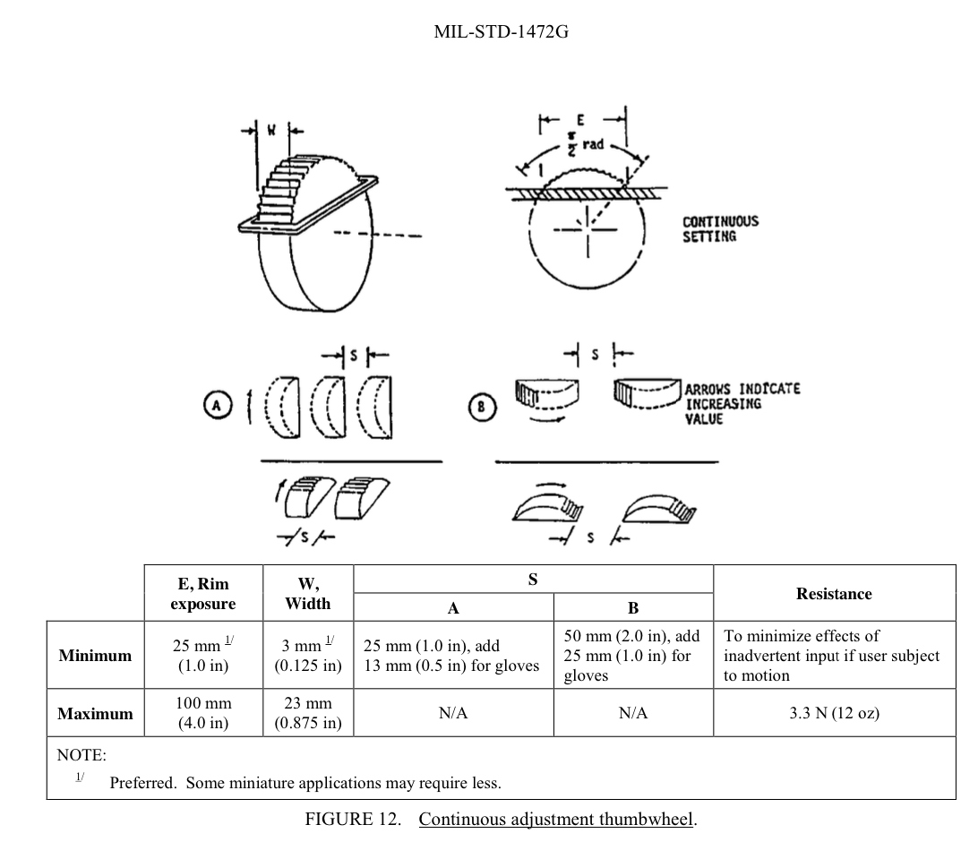
MIL-STD-1472G

Slide 6
For ProArt protable monitor…
Wheel (the outer circle):
To provide easier operation, concave-shape is prefered. Also, it should have nonslip surface.
Since it is designed for fingertips operation, 10mm in width is recommended.
Users might scroll the wheel from the side of the monitor. In this scenario, we recommend the wheel to be at least 3mm thick. At the same time, have at least 1 inch of its rim exposed.
Push-button (the centre):
10mm in diameter is recommended. It should have nonslip surface as well.

